Slide 1


LEAVING CERTIFICATE APPLIED 2026

Slide 2
WHAT IS LEAVING CERTIFICATE APPLIED?
It is a distinct, self-contained two-year Leaving Certificate programme aimed at preparing learners for adult and working life.
It offers learners specific opportunity to prepare for and progress to further education and training.
The two years are broken into 4 sessions.
Achievement is credited in each session.

Slide 3
WHY?
We wanted to offer students a broader range of options at Senior Cycle.
A growing percentage of our students are going directly to work, apprenticeships or PLC/Level 5 courses.
Staff felt that there was a cohort of students who would be better served by LCA than LCE.
Staff Survey in March 2025 -100% support for introduction of LCA.

Slide 4
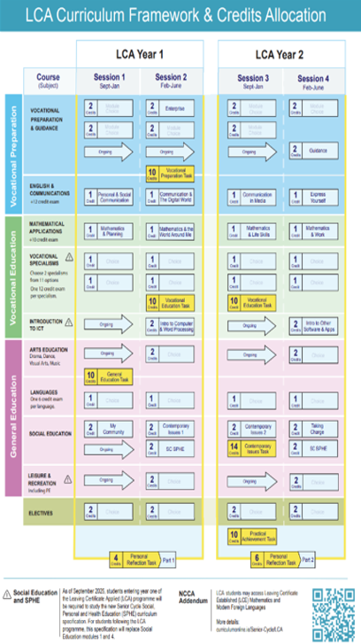

Slide 5

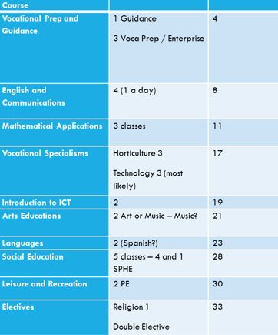

Slide 6
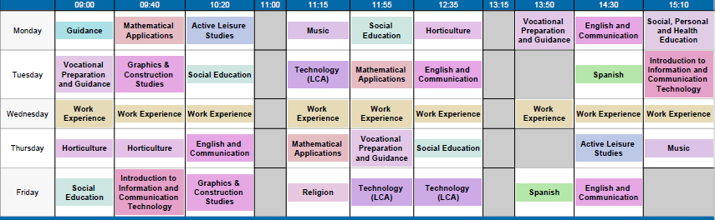

Slide 7
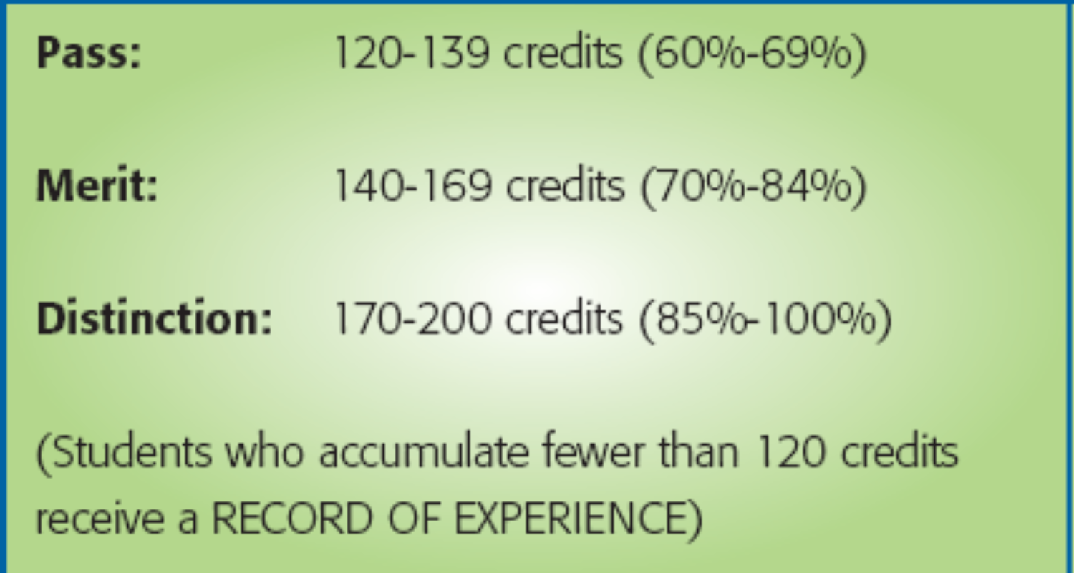
Assesment
90% attendance
Students will complete a number of modules (usually 8) in each subject area and there will be 4 key assignments per module.
Some courses will require Tasks to be completed.
A Task = a project on a Practical Task
7 tasks over 2 years.
These are interviewed by an external examiner
Some subjects will have a final written exam in June also (Irish in 5th Year)
Oral language exam in 5th year (Irish) and 6th year
Work Experience one day per week. Most likely Wednesday

Slide 8
WHO? - 3RD YEAR 2025/TY 2025
Someone who prefers learning by doing
Someone who would be motivated by continuous assessment
Someone at risk of early school leaving
Someone who the traditional LC does not suit
Someone who wants to get work experience to help them with their career choice
Someone who wants to develop skills which help them in their future career

Slide 9
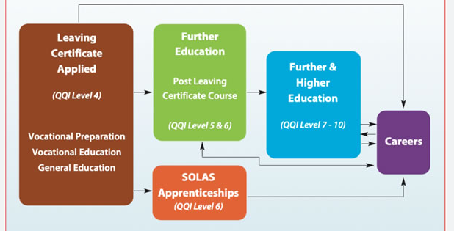

Slide 10

Thank You.
Any Questions?

