Slide 1

Options after School and CAO Application Process
Information for Parents
17/11/2025

Slide 2
Structure of this evening
This evening’s talk will be divided into two parts:
1. Look at the various options available for the boys once they complete their Leaving Certificate
2. CAO Application Process

Slide 3
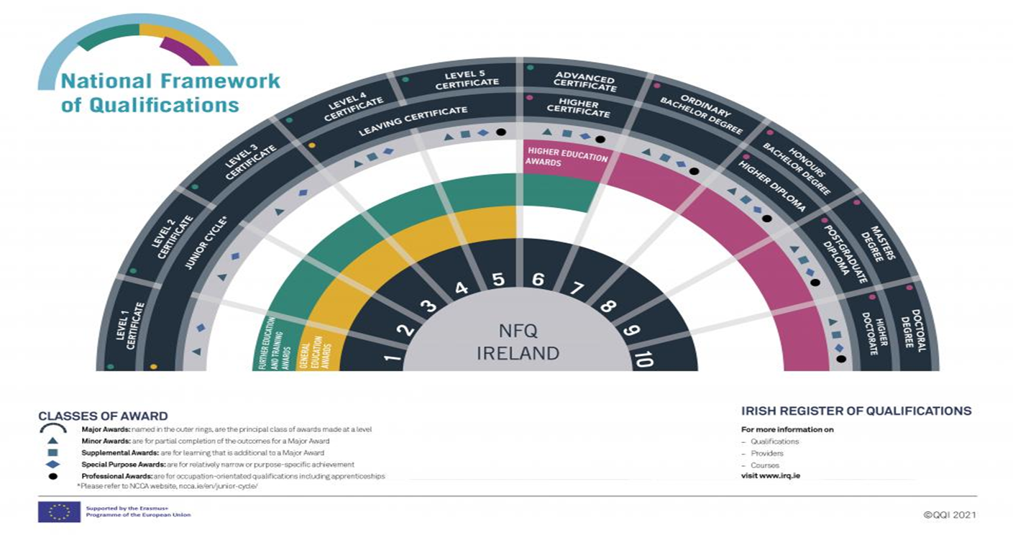
National Framework of Qualifications (N.F.Q.)

Slide 4
What are our options?
Work
Apprenticeship
Further Education – PLC
Tertiary Degrees
Higher Education – Abroad
Higher Education - CAO

Slide 5
1. Work
Leaving Cert is Level 5 on National Framework of Qualifications
Straight to the workforce:
Chance of promotion can be affected but not always
Generally stay at Level 5 but some go back to education later in life
Many examples of people who have had great careers through this route
Our economy needs this

Slide 6
2. Apprenticeship
Level 6+ on NFQ
Combines and alternates learning in the workplace with learning in an education or training centre – blended approach.
It is a combination of on-the-job employer-based training and off-the-job training in an education setting.
Minimum entry requirements vary depending on Apprenticeship.
75+ Apprenticeships to choose from:
https://content.apprenticeship.ie/f/83224/x/172746043e/2025-09-22-list-of-apprenticeships-as-of-sep.pdf

Slide 7
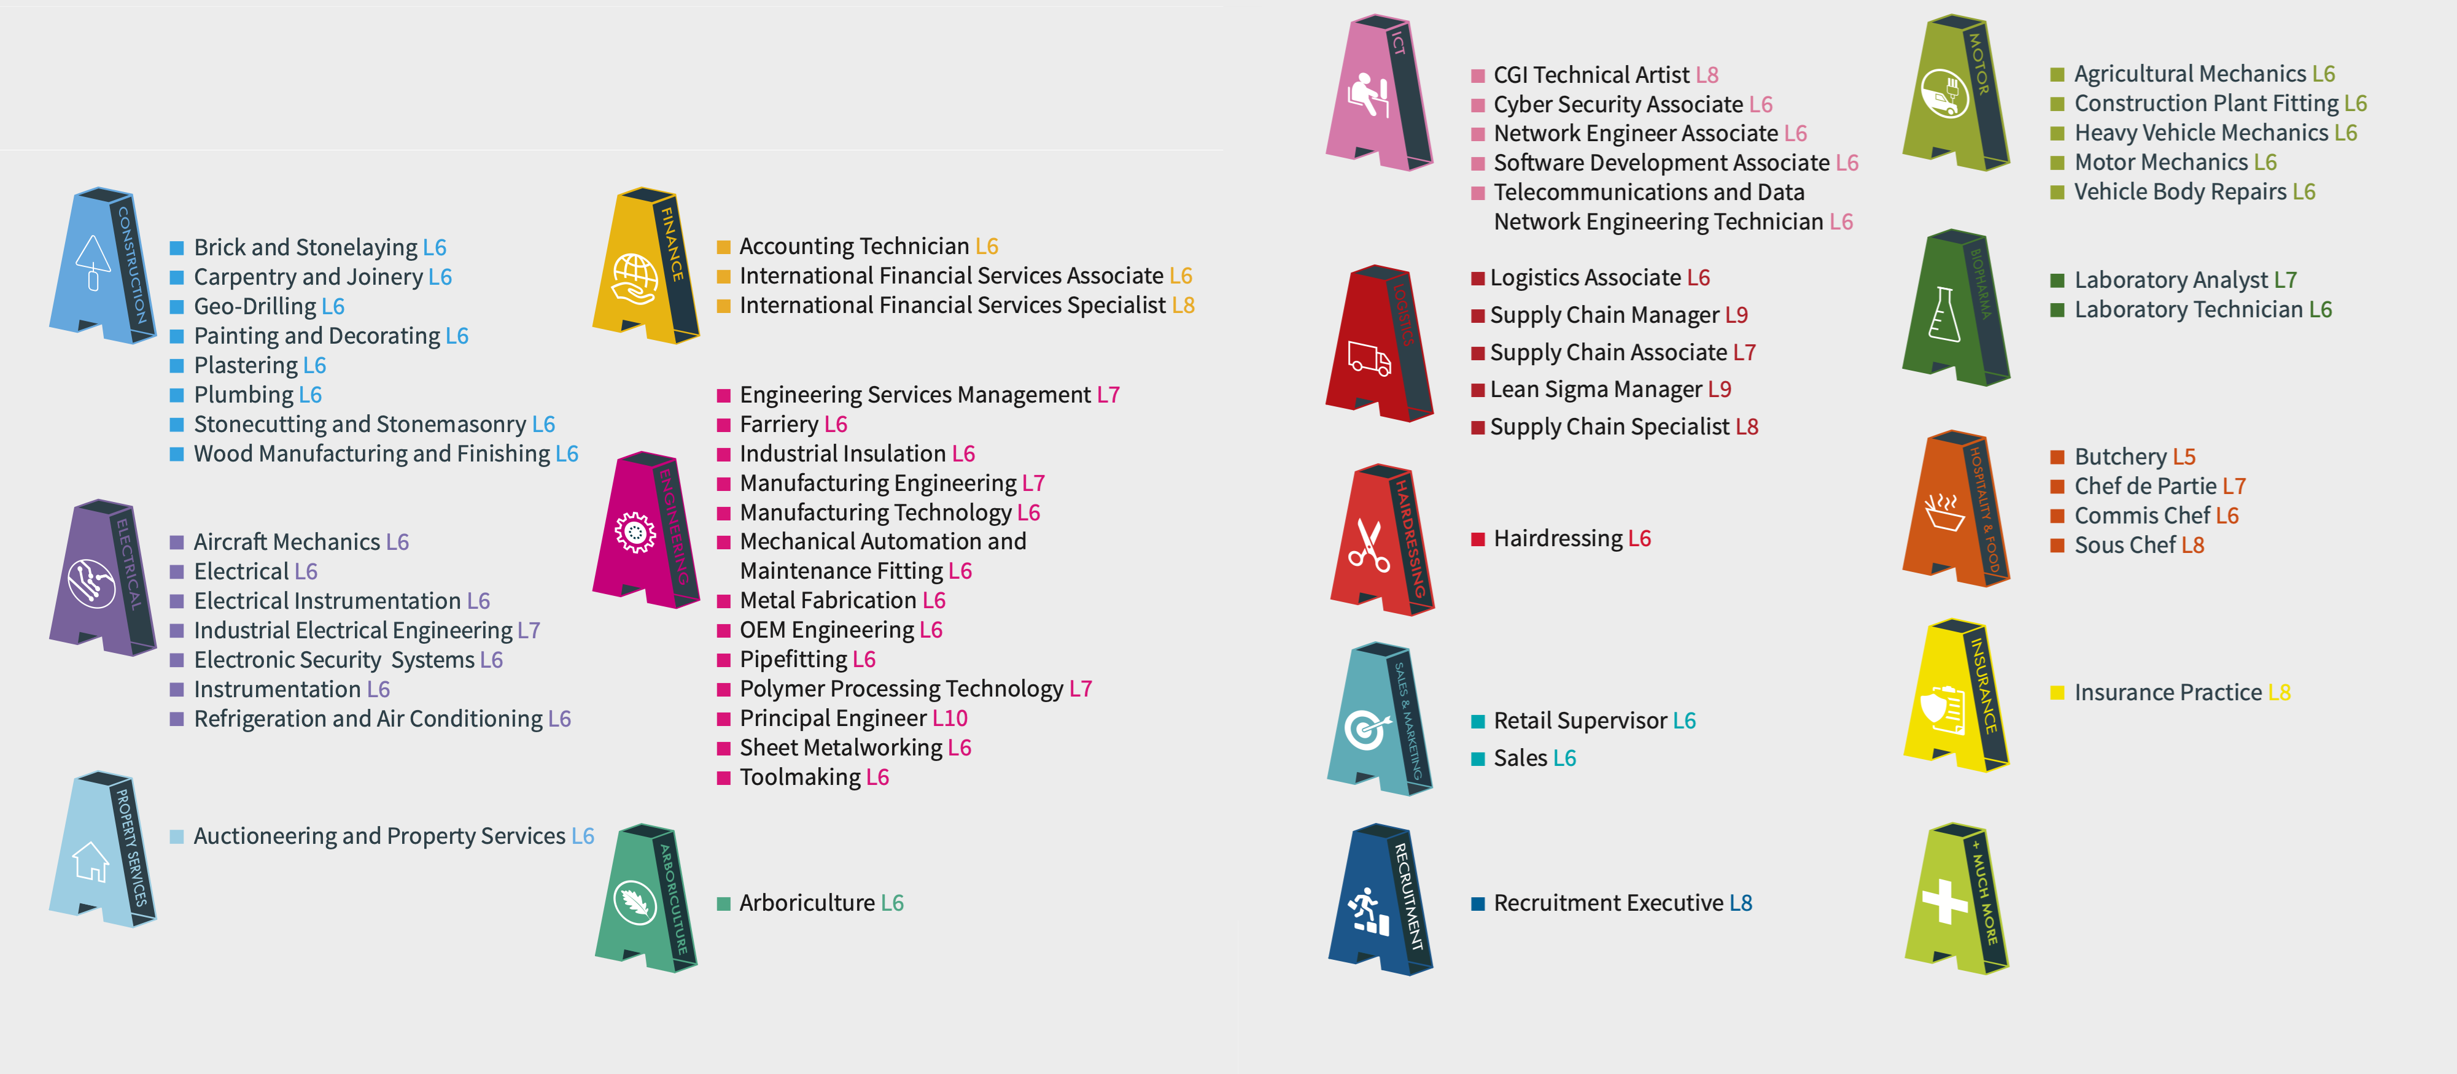
2. Apprenticeships

Slide 8

3. Further Education
Further education is education and training that happens after second-level schooling, but which is not part of the third-level system
PLC – Post Leaving Cert Courses
These courses last one to two years and lead to an award on the National Framework of Qualifications at NFQ Level 5 or NFQ level 6
Why do a PLC?
The courses develop technical and practical skills for an industry recognised qualification.
They offer an alternative route to higher education
They can give you the opportunity to try out a subject of interest to you.

Slide 9
3. Further Education
PLC courses take place in schools, colleges and community education centres. The courses offer a mixture of practical work, academic work and work experience. They are designed as a step towards skilled employment and, as such, they are closely linked to industry and its needs.
Almost half of the time spent on these courses is devoted to knowledge and skill training related to employment, with a further quarter spent on relevant work-based experience.
Most PLC courses are delivered by Education and Training Boards (ETBs). A wide range of disciplines are covered including:
Business
Electronics engineering
Computing
Catering
Sport and leisure

Slide 10
Post Leaving Cert Courses Carlow
The following courses are available in Carlow:
https://carlowinstitute.ie/courses-az/
Similar Courses are available throughout Ireland

Slide 11
4. Tertiary Degrees
Tertiary degrees are an alternative pathway to a Level 7 or 8 undergraduate degree that combines further education and higher education.
Students start their studies at a local Education and Training Board (ETB) college and then seamlessly progress to a higher education institution (HEI) to complete their degree, graduating from the HEI.

Slide 12
These programs offer benefits such as no points race for entry, smaller class sizes, and a guaranteed progression path to the HEI upon successful completion.
Tertiary Degrees are co-designed and co-delivered by the Education and Training Boards and Higher Education Institutions to provide seamless pathways from Further Education to Higher Education.
National Tertiary Office :
https://nto.hea.ie/courses/

Slide 13

5. Study Abroad
Any students/parents considering this option should come see me as soon as possible.
Studying in Europe – a full list of courses can be found at https://www.eunicas.ie/
Studying in Europe is often an option for those seeking courses that are very high points in Irish University’s
Options to study courses such as Veterinary Science, Medicine and Physiotherapy through English

Slide 14
Studying in the UK
UCAS (University and Colleges Admissions Service) is the central applications body for full-time undergraduate courses at UK universities and colleges.
UCAS website contains all the information you need to apply to college including: how to apply, fees and information about the colleges. Applications must be made online through the UCAS website
Use the UCAS tariff calculator which is a points system used for entry to higher education. It allows you to compare Leaving Certificate and GCSE A level grades.
As an Irish Citizen within the Common Travel Area you will be treated in the same way as regards fees as UK students. Tuition fees are not the only expense when studying in the UK you also need to consider accommodation and living costs.

Slide 15
6. Higher Education - CAO
Third Level Education
These courses are at Level 6-10 on NFQ
Students can apply for Courses at Level 6-8 directly from Leaving Cert
Applications for Higher Educations courses are through the Central Applications Office (CAO)

Slide 16

Universities
There are 7 universities in Ireland. These include:
The National University of Ireland (NUI) which is the umbrella university covering
University College Dublin (UCD)
University of Galway
University College Cork
Maynooth University.
Trinity College Dublin (TCD)
The University of Limerick (UL)
Dublin City University (DCU)

Slide 17
Technological Universities
There are 5 technological universities:
Technological University Dublin (TU Dublin) – formerly Dublin, Tallaght and Blanchardstown institutes of technology
Munster Technological University MTU) – formerly Cork and Tralee institutes of technology
Technological University of the Shannon: Midlands Midwest (TUS) – formerly Limerick and Athlone institutes of technology
Atlantic Technological University (ATU) – formerly Galway-Mayo, Sligo and Letterkenny institutes of technology.
South East Technological University (SETU) – formerly Carlow and Waterford institutes of technology.

Slide 18

Institutes of Technology
There are 2 institutes of technology:
Institute of Art, Design and Technology (IADT), Dun Laoghaire
Dundalk Institute of Technology
Other colleges:
Eg. Carlow College

Slide 19
CAO - Important Dates
Important dates:
5/11/25 - CAO online application facility opens.
20/1/26 – Application cost increases to €50
1/2/26 – Closing date for applications
5/5/26 – Change of mind facility opens
1/7/26 – Change of mind facility closes

Slide 20

Your role as a parent/guardian
Help your son research courses
Encourage your son to apply soon if they have not yet
Make sure they list their courses in GENUINE ORDER OF PREFERENCE
Watch out for important deadlines
Remind your son to review all CAO correspondence carefully
Accept offer on-line by the reply date

